Slide 1
Welcome to Psychology
We hope you are going to enjoy your time in Lancaster, and with the Department
We hope you are going to learn a lot and enjoy this course about psychological analysis
Did I really use “analysis” and “enjoy” in the same sentence??
Can analysis be a useful, everyday tool?

Slide 2
How to succeed with Analysis
Keep up with the lectures
Apply yourself in the lab classes
Keep practicing until ideas fall into place
Please don’t misinterpret this course to be just about numbers and calculations
It’s actually about ideas and problem solving and being thoughtful

Slide 3
Structure of Analysis course
Week 1-5: Introduction to analysis (John Towse)
Week 6-10 Testing for differences (Tom Beesley)
Christmas break!
Week 11-15 Testing for associations (Margriet Groen)
Week 16-20 Using and interpreting statistical information (Rob Davies)

Slide 4
Evidence in psychology
"In listening to stories we tend to suspend disbelief in order to be entertained, whereas in evaluating statistics we generally have an opposite inclination to suspend belief in order not to be beguiled.”
John Allen Paulos, in Stories vs. statistics, New York Times, 24 October 2010

Slide 5
Overview of next three weeks
Groundwork for the course
Ways of expressing statistical ideas
Ways to represent a dataset (a pack of numbers)
Central tendency
Variability or spread
Sampling and sample size
Describing where one number falls in a set of numbers

Slide 6
Learning outcomes
By the end of the lecture you should be able to:
Understand distinctions between types of data
Be aware of some key notations for discussing numbers
Be aware of measures of central tendency

Slide 7
Overview
Variables can be anything that vary
This lecture considers:
Types of data
Different scales of measurement
The different functions of statistics
The need to understand the characteristics of each of your variables is emphasised

Slide 8
Types of Data
Broadly speaking, there are two types of data
The first type is called ‘nominal’ data
Nominal variables are those in which a case falls into one of two or more categories
Examples are gender, eye colour, socio-economic status, marital status and nationality
Nominal variables are also referred to as categorical or qualitative variables

Slide 9
Types of Data (Continued)
The second type of data is called ‘numerical’ data
Numerical variables are those in which a case is assigned a numerical value
Examples are age, height, weight, IQ, test scores, income, distance or temperature
Numerical variables are also referred to as score or quantitative variables

Slide 10
Nominal or Numerical?
Which type of data are each of the following?
Facebook user (i.e. yes or no)
Use of Facebook (i.e. hours per day)
Network (i.e. number of friends on Facebook)
How do you access Facebook (i.e. mobile phone, PC or laptop)
Use of Facebook (i.e. Less than five hours per day or at least five hours per day)

Slide 11
Scales of Measurement
Four different scales of measurement exist:
Nominal categorisation – Placing cases into named categories (e.g. sprinters could be categorised based on their nationality)
Ordinal categorisation – This ranks cases based on their order on a given variable (i.e. sprinters can be ranked 1st, 2nd, 3rd etc.)
Interval categorisation – Where the distances between the sequential points on the scale are equal (e.g. the temperature at the time of the race)
Ratio categorisation – The same as interval categorisation, but with an absolute zero (e.g. the sprinters’ best times)

Slide 12
Functions of Statistical Techniques
Statistical techniques perform three key functions:
Descriptive statistics, as you would guess, is used to describe the information collected
Inferential statistics relates to the confidence with which we can generalise from our sample to the population of interest
Data reduction techniques allow a researcher to make sense of large amounts of data through using more advanced statistics

Slide 13
Interim Conclusions
Data comes in two broad forms
Nominal variables are those in which cases are placed in categories
Numerical variables concern those in which cases are given a score value
It is important to understand which of these types of data each of your variables are as this will influence your analysis
The measurement of a variable can take four forms: nominal, ordinal, interval and ratio
Statistics can be used to describe, make inferences about or reduce your data

Slide 14
Notation
Scores for a particular variable are generally represented by the letter X
Scores for two variables are generally represented by X and Y
The number of scores in a distribution is represented by N.
∑X (“sigma X”) is the sum of X scores
M refers to the arithmetic mean of the scores

Slide 15
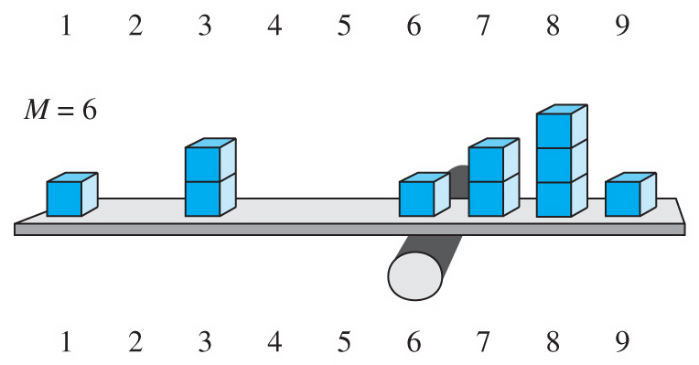
Central tendency
The mean is the average from a set of scores
M = ∑X /N

Slide 16
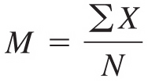
The mean
What is the mean of 7,8,8,7,3,1,6,9,3,8?
ΣX = 7+8+8+7+3+1+6+9+3+8 = 60
N = 10
Mean = 60/10 = 6

Slide 17
The median
The middle score when all scores are arranged from lowest to highest
Median of 7,8,8,7,3,1,6,9,3,8
1 3 3 6 7 7 8 8 8 9
median
Median is the average (mean) of the 5th and 6th scores, so the median is 7

Slide 18
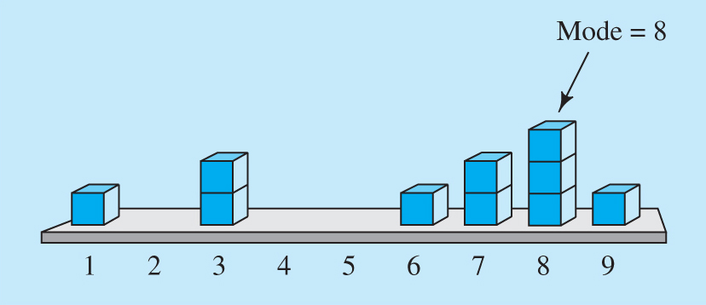
The mode
Most common single number in a distribution
Mode of 7,8,8,7,3,1,6,9,3,8
1 3 3 6 7 7 8 8 8 9
Mode is 8

Slide 19
Thinking about central tendency
“Of the three, which measure of central tendency should be used?
Why do we need three measures?”
Questions without a simple answer
Examples of where some measures may be misleading or controversial
Examples where the mean isn’t meaningful
Examples where the mean isn’t possible
Notes:
Paulos begins with the familiar example of housing prices, and goes on to discuss the implications for interpreting newly released data on the performance of the US economy for 2004. Republicans point out that the economy grew at a rate of 4.2%, and complain that they are not getting enough credit for the good news. Democrats counter that real median income is falling and poverty is rising. How can both be true? Just as a few expensive houses in a neighborhood can pull the mean substantially above the median, gains by a wealthy few at the top of the income ladder can pull up the mean, even if most people are not benefiting.To show that this is happening, Paulos cites work on income distribution by economists Thomas Picketty and Emmanuel Satz. According to their calculations, the the richest one percent, whose incomes exceed $315,000, gained on average nearly 17% over the year in question. However, the good news did not extend very far down the income distribution. Looking at the top five percent of all incomes, the average gain is described as "minimal." This means that the gains were concentrated near the very top. In fact, even among the top one percent, Picketty and Satz found that half of income gains went to the top tenth of the group.

Slide 20

Using statistics carefully

Slide 21
Summary
Psychology involves using data in different ways
This can make a big difference you how we handle data
We need to understand the scale of data
Central tendency describes representative values
Different types of central tendency measure
Ask yourself which is better in the circumstances

